Slide 1


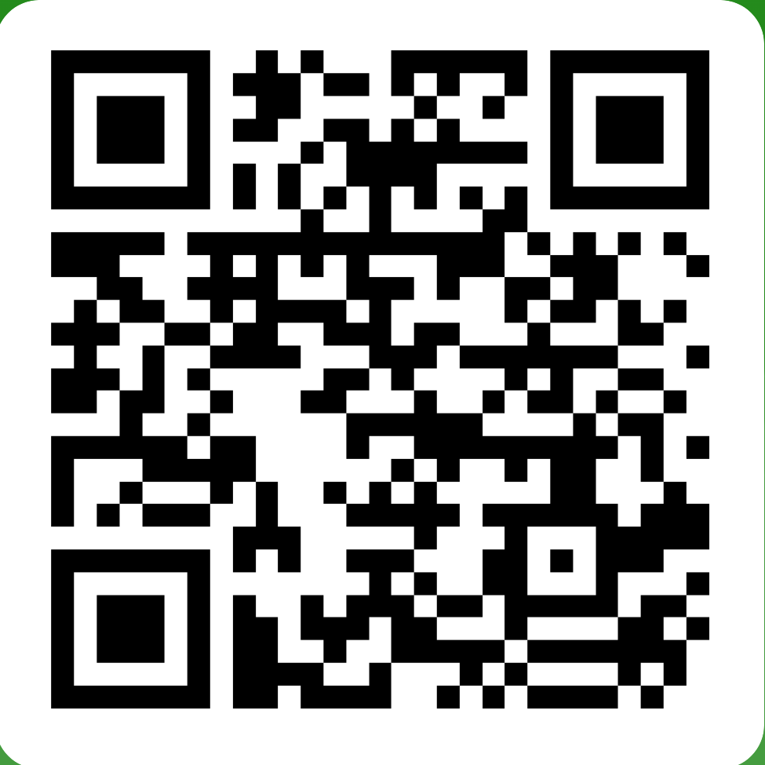
CAMHS ONLINE WELL BEING WORKSHOPS
26th March – 4th April 2024
CAMHS will be running a range of workshops on MS Teams in February Half Term 2024 for young people in year 6 & above, and their families across Gwent.
Please use the booking form/QR code below and make sure to book on at least 24 hours before the session.
Parents are welcome to attend with their young person, but we will not be able to answer any individual CAMHS queries during the workshop time.
UNDERSTANDING EMOTIONS
This workshop explores feelings and emotions while offering new ways to regulate our emotions.
WHEN?
Wednesday 27th March 11:00am – 1:00pm
Tuesday 2nd April 2:00pm – 4:00pm
5 WAYS TO WELLBEING
This workshop shares tips and ideas on easy ways that you can actively improve your own well-being
WHEN?
Tuesday 26th March 2:00pm – 4:00pm
Wednesday 3rd April 11:00am – 1:00pm
BOOKING INFORMATION
To register for one of the listed sessions, follow the Microsoft Forms link or scan the QR code:
https://forms.office.com/e/u2kFvvZ3FB

Slide 2
GWEITHDAI LLES AR-LEIN CAMHS
26^{ain} Mawrth – 4^{ydd} Ebrill 2024
Bydd CAMHS yn cynnal amrywiaeth o weithdai ar MS Teams yn ystod Hanner Tymor Chwefror 2024 ar gyfer yr holl blant, pobl ifanc Blwydden 6 ac uwch a'u teuluoedd ledled Gwent. Defnyddiwch y ffurflen archebu/cod QR isod a gwnewch yn siŵr eich bod yn archebu o leiaf 24 awr cyn y sesiwn.
Mae croeso i rieni fynychu gyda'u person ifanc, ond ni fyddwn yn gallu ateb unrhyw ymholiadau CAMHS unigol yn ystod amser y gweithdy.
DEALL EMOSIYNAU
Gweithdy yn archwilio teimladau ac emosiynau tra'n cynnig
ffyrdd newydd o reoli ein hemosiynau
PRYD?
Dydd Mercher 27ain Mawrth 11:00yb – 1:00yp
Dydd Iau 2ail April 2:00yp – 4:00yp
5 LLWBR I LLES
Gweithdy yn rhannu awgrymiadau a syniadau ar ffyrdd hawdd
y gall myfyrwyr fynd ati i wella eu lles eu hunain.
PRYD?
Dydd Mawrth 26ain March 2:00yp – 4:00yp
Wednesday 3ydd April 11:00yb – 1:00yp
MANYLION BWCIO
I gofrestru ar gyfer un o'r sesiynau yma, dilynwch y
ddolen Microsoft Forms neu sganiwch y cod QR:
https://forms.office.com/e/u2kFvvZ3FB

Slide 3
CAMHS ONLINE WELL BEING WORKSHOPS
26th March – 4th April 2024
CAMHS will be running a range of workshops on MS Teams in February Half Term 2024 for young people in year 7 & above, and their families across Gwent.
Please use the booking form/QR code below and make sure to book on at least 24 hours before the session.
Parents are welcome to attend with their young person, but we will not be able to answer any individual CAMHS queries during the workshop time.
UNDERSTANDING EMOTIONS
This workshop explores feelings and emotions while offering new ways to regulate our emotions.
Wednesday 27th March 11:00am – 1:00pm
Tuesday 2nd April 2:00pm – 4:00pm
5 WAYS TO WELLBEING
This workshop shares tips and ideas on easy ways that you can actively improve your own well-being
Tuesday 26th March 2:00pm – 4:00pm
Wednesday 3rd April 11:00am – 1:00pm
UNDERSTANDING ANXIETY & WORRY
This workshop explores what anxiety is and sharing strategies to manage feelings of anxiety in a positive way
Wednesday 27th March 2:00pm – 4:00pm
Tuesday 2nd April 2:00pm – 4:00pm
LOOKING AFTER YOUR SELF DURING EXAM SEASON
This workshop helps to understand what stress is, how it can present itself in the body and providing strategies to combat the impact of exam stress
Tuesday 26th March 11:00am – 1:00pm
Thursday 28th March 2:00pm – 4:00pm
Thursday 4th April 11:00am – 1:00pm
BOOKING INFORMATION
To register for one of the listed sessions, follow the Microsoft Forms link or scan the QR code:
https://forms.office.com/e/u2kFvvZ3FB

Slide 4
GWEITHDAI LLES AR-LEIN CAMHS
26^{ain} Mawrth – 4^{ydd} Ebrill 2024
Bydd CAMHS yn cynnal amrywiaeth o weithdai ar MS Teams yn ystod Hanner Tymor Chwefror 2024 ar gyfer yr holl blant, pobl ifanc Blwydden 7 ac uwch a'u teuluoedd ledled Gwent. Defnyddiwch y ffurflen archebu/cod QR isod a gwnewch yn siŵr eich bod yn archebu o leiaf 24 awr cyn y sesiwn.
Mae croeso i rieni fynychu gyda'u person ifanc, ond ni fyddwn yn gallu ateb unrhyw
ymholiadau CAMHS unigol yn ystod amser y gweithdy.
DEALL EMOSIYNAU
Gweithdy yn archwilio teimladau ac emosiynau tra'n cynnig
ffyrdd newydd o reoli ein hemosiynau
Dydd Mercher 27^{ain} Mawrth 11:00yb – 1:00yp
Dydd Iau 2^{ail} April 2:00yp – 4:00yp
5 LLWBR I LLES
Gweithdy yn rhannu awgrymiadau a syniadau ar ffyrdd hawdd
y gall myfyrwyr fynd ati i wella eu lles eu hunain.
Dydd Mawrth 26^{ain} Mawrth 2:00yp – 4:00yp
Dydd Mercher 3^{ydd} Ebrill11:00yb – 1:00yp
DEALL PRYDER
Gweithdy yn archwilio beth yw gorbryder a rhannu strategaethau i
reoli teimladau o bryder mewn ffordd gadarnhaol
Dydd Mercher 27^{ain} Mawrth 2:00yp – 4:00yp
Dydd Mawrth 2^{ain} Ebrill 2:00yp – 4:00yp
EDRYCH AR OL EICH HUN Y YSTOD TYMOR ARHOLIAD
Gweithdy 1.5 awr yn cefnogi myfyrwyr I ddeall beth yw straen, sut y gall gyflwyno ei hun yn y corff a darparu strategaethau i frwydro yn erbyn effaith straen arholiadau
Dydd Mawrth 26^{ain} Mawrth 11:00yb – 1:00yp
Dydd Iau 28^{ain} Mawrth 2:00yp – 4:00yp
Dydd Iau 4^{ydd} Ebrill 11:00yb – 1:00yp
MANYLION BWCIO
I gofrestru ar gyfer un o'r sesiynau yma, dilynwch y
ddolen Microsoft Forms neu sganiwch y cod QR:
https://forms.office.com/e/u2kFvvZ3FB

